Slide 1
Presentation of calculas
Name : Mubashir Ali
Roll No: 2k20/ITE/73
Topic 1: Integration by Completing the square
Topic 2: Partial Fraction Decomposion

Slide 2
Partial Fraction Decomposion
In algebra, the partial fraction decomposition or partial fraction expansion of a rational fraction is an operation that consists of expressing the fraction as a sum of a polynomial
Fractions.
Sal explains what partial fraction expansion is by rewriting (x²-2x-37)/(x²-3x-40) as the sum of 1 and two rational expressions with linear denominators.

Slide 3
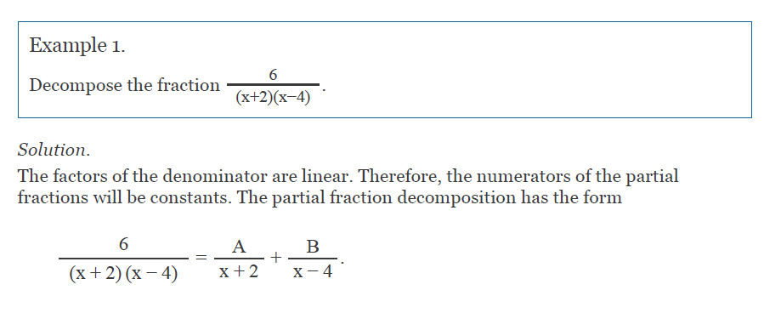
We add the partial fractions on the right side

Slide 4
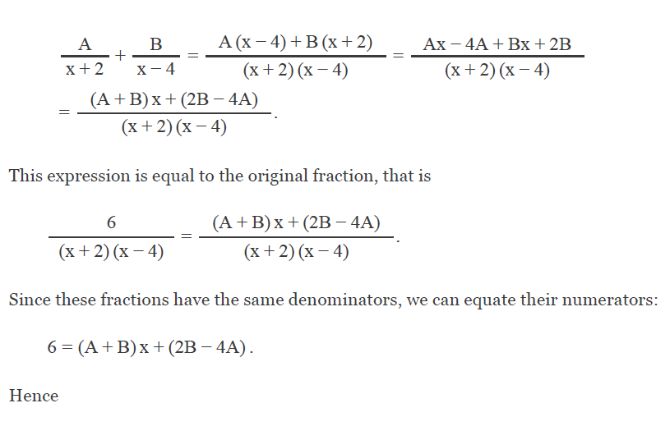

Slide 5
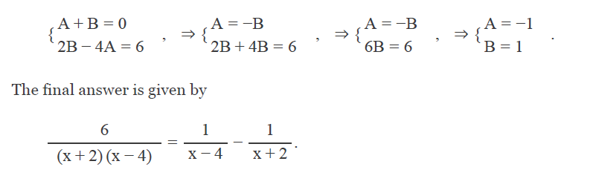

Slide 6
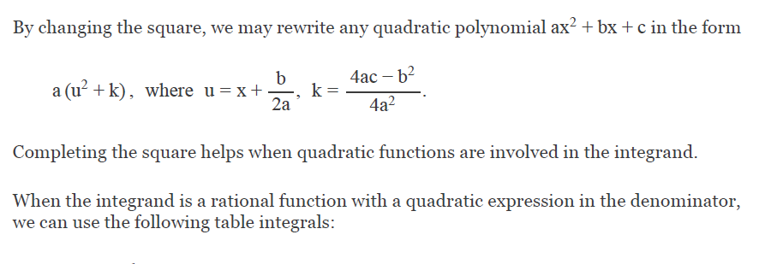
Integration by Completing the square

Slide 7
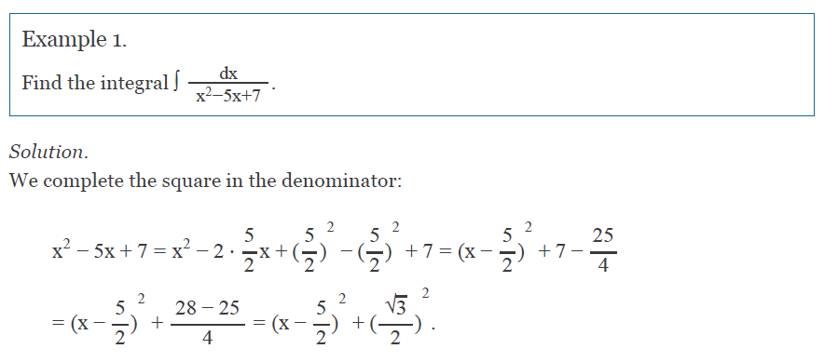

Slide 8
